Slide 1

Web Mapping with Carto
Alison Blaine & Jennifer Garrett

Slide 2
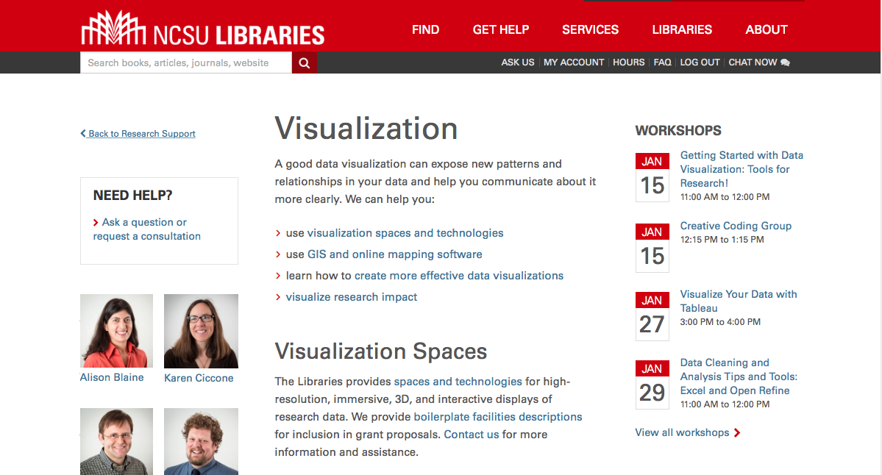
Data Visualization Services lib.ncsu.edu/do/visualization

Slide 3
Making Maps for the Web: Considerations
Web maps are digital, and rely on internet architecture, servers and protocols to display information - there are positives and negatives with that!
Designing for various screen sizes
Most web mapping tools are versatile and allow you to download maps as an image for use in a presentation, or embed them in a website.
Web maps are great for interactivity - users can engage with the data, hover over things and get more information

Slide 4
Categories of software out there
No coding required
Carto
ArcGIS Online
Tableau
ZeeMaps
Google FusionTables
Prospect (a wordpress plugin)
Coding required
MapBox
Leaflet
Google Maps API
Kartograph

Slide 5
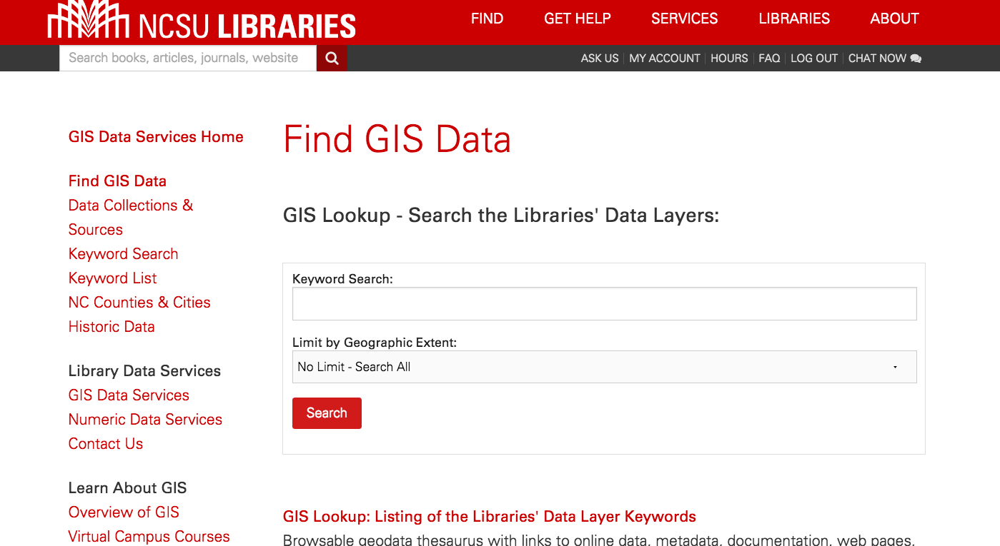
Resource for finding geographic data
https://www.lib.ncsu.edu/gis/data.html

Slide 6
CartoDB Use Cases
Make a map for a website, large-scale display, or mobile application (responsive)
Make a static image of a map to include in a report
Make an interactive map that supports investigation, drilling-down/filtering data
Make a map for quick data exploration of geospatial data
Turn your ArcGIS or QGIS projects into web maps
Twitter harvest and map tweets (only with paid service)

Slide 7
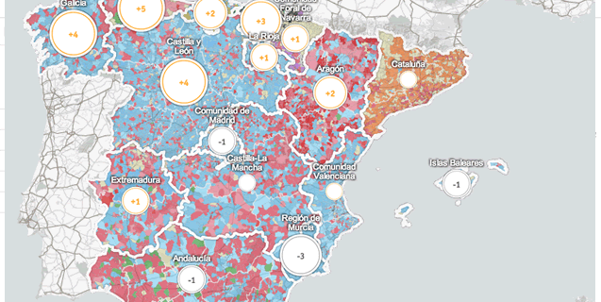
Developer features
Write your own custom CSS code to style your map (if you want to)
Import data from the web using various coding languages
Integrate your map into a web application using a Javascript package provided by Carto

Slide 8
Strengths and weaknesses
Compatibility with QGIS and ArcGIS, more sophisticated tools. Link those projects to your Carto account.
Does not allow you to make your maps or data private unless you upgrade.
Allows you to write SQL statements and customize the map with CSS

Slide 9
Today’s workshop materials
go.ncsu.edu/cartodb

